Slide 1
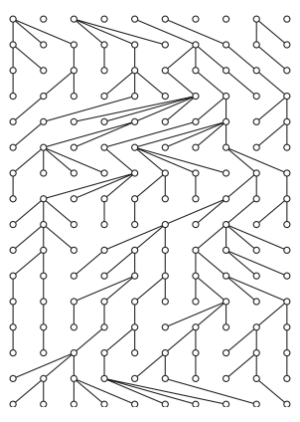
The wright-fisher model
A very basic introduction

Slide 2
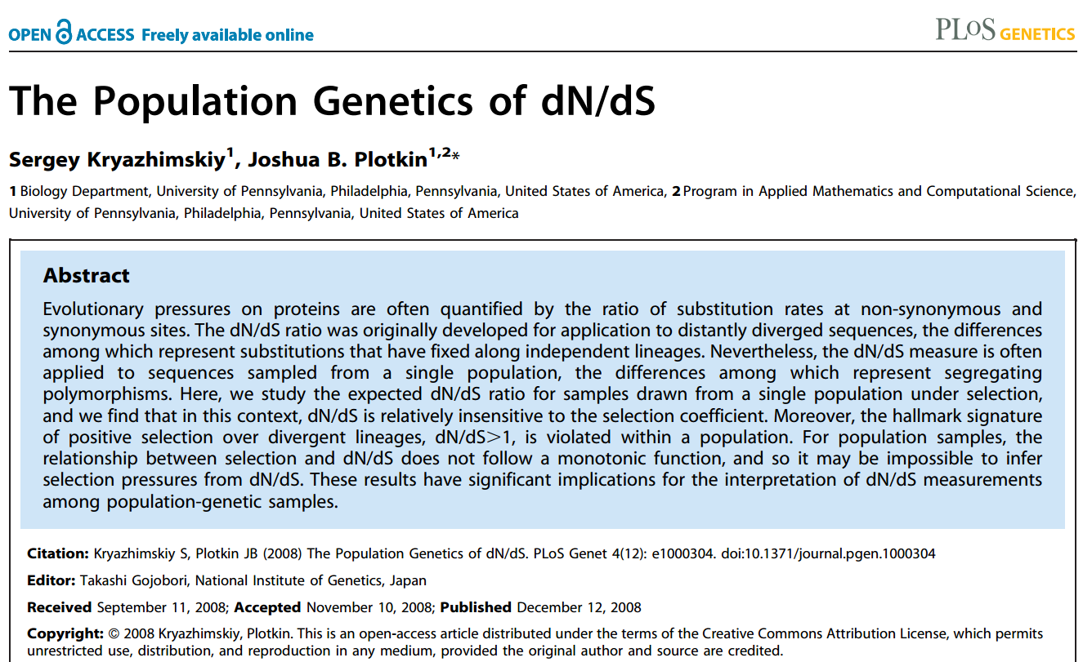
The paper and the idea

Slide 3
Meet the model...
describing the genealogical relationship among genes
dynamic description of the evolution of an idealised population and the transmission of genes from one generation to the next.

Slide 4
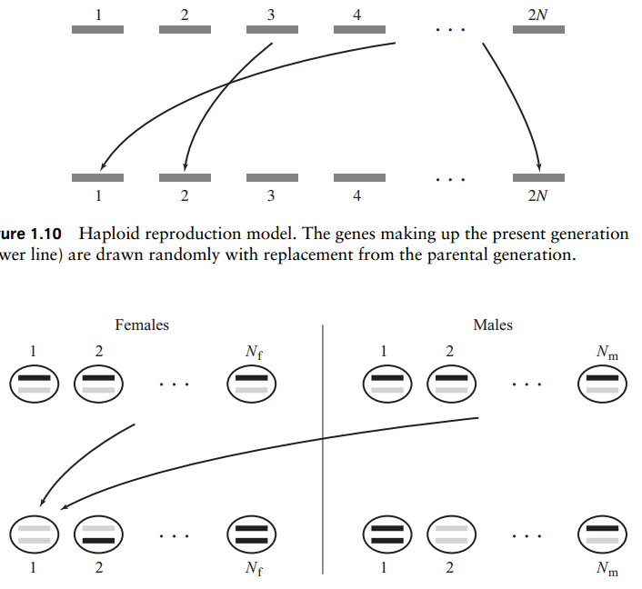
Schematic overview
Haploid
Diploid

Slide 5
Assumptions of the model
Discrete and non-overlapping generations
Haploid individuals or two subpopulations (males and females)
The population size is constant
All individuals are equally fit
The population has no geographical or social structure
The genes (or sequences) in the population are not recombining
→ Modelling Genetic Drift! (but selection can be included)

Slide 6
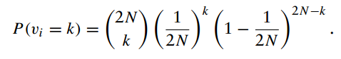
How the model works
We consider a diploid population of size N
At a given locus, there could be either one of the two alleles A1 and A2
The population reproduces in discrete time steps
the alleles in generation n+1 (children) are chosen by random sampling with replacement from the ones in generation n (parents)
Let vi be the number of descendants of gene i in generation t, then
A2
A1
This is an example of the binomial distribution, Bi(m,p), with parameters:
m=2N and p=1/(2N)
The number of genes descending from a given gene is binomially distributed

